Slide 1
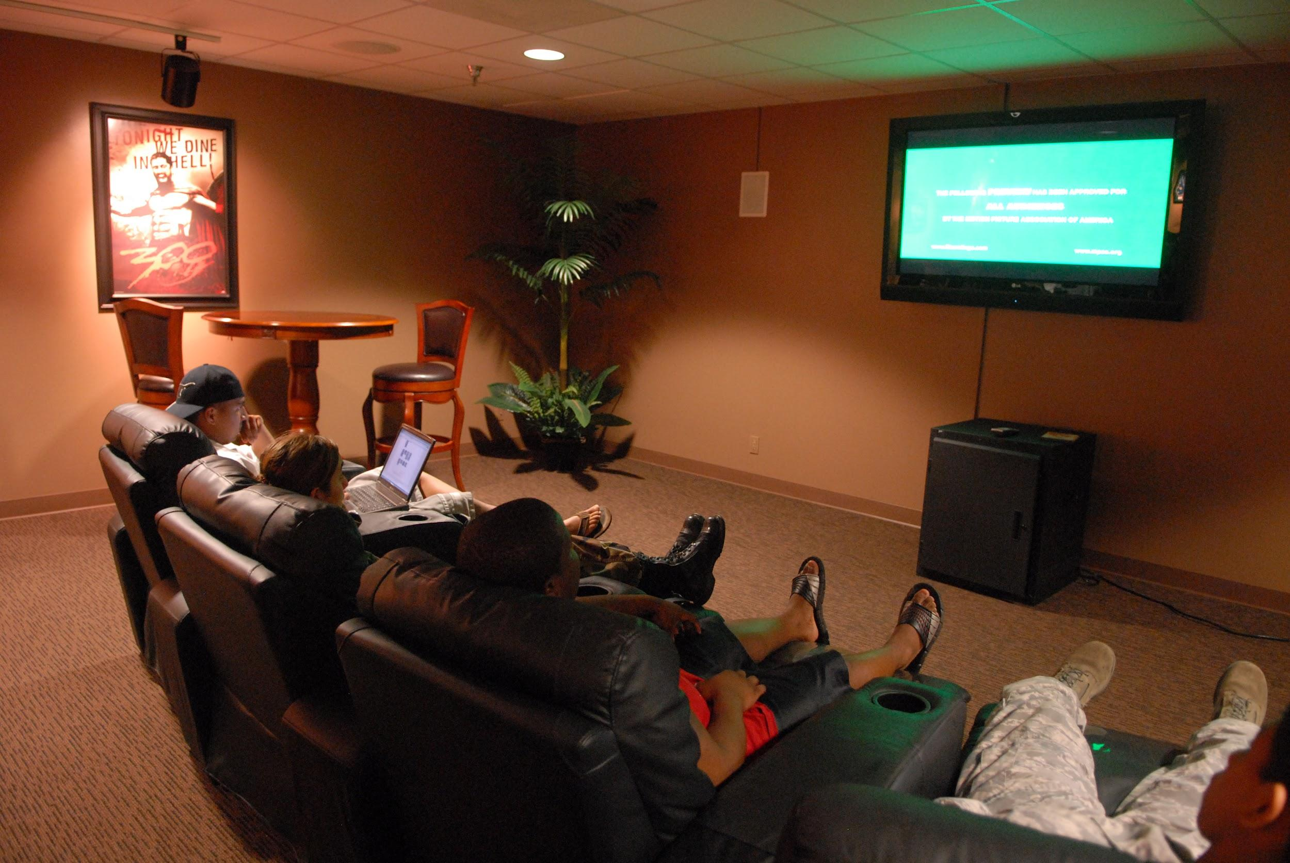

What shows to bring to Netflix?
Erik Paulson

Slide 2


Data:
Kaggle dataset of all current United States Netflix titles in May 2022
https://www.kaggle.com/datasets/victorsoeiro/netflix-tv-shows-and-movies
Tools:
Google Sheets for filtering/analysis
Tableau for filtering/visualisations

Slide 3


Why add more titles to Netflix?
Maintain/increase membership
Keep genres fresh for viewers
Increase viewership by adding related titles

Slide 4


People have varying interests!
Some people would like to watch something “easy and relaxing” while others want something “exhilarating or heart-pumping”
Top Three Categories! War movies | History movies | Documentation movies
Movies or Shows? People prefer shows to movies!
Simple Let’s give people more of what they like!

Slide 5

What would it take to bring more viewership hours to Netflix?
The goal:
Bring more content that more viewers want to Netflix and reduce churn!

Slide 6

We can expect people to enjoy movies from the same genres
So let’s add to low title genres!

Slide 7
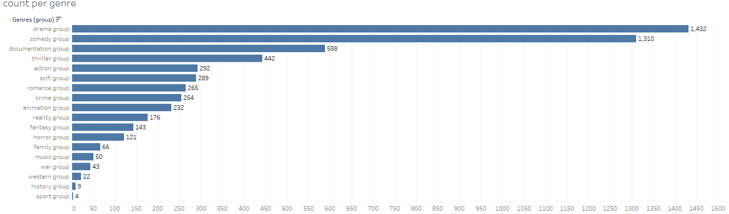
Count of Movies per Genre

Slide 8
Note that some genres have significantly more titles than others!
Maybe some viewers want more of their favorite genres

Slide 9
What is your favorite movie genre?
With a little help from Google Sheets and
Tableau we can see many favorites!
Interesting idea:
Are the highest rated movies the most popular? Or do they have the most vocal fanbase? .

Slide 10

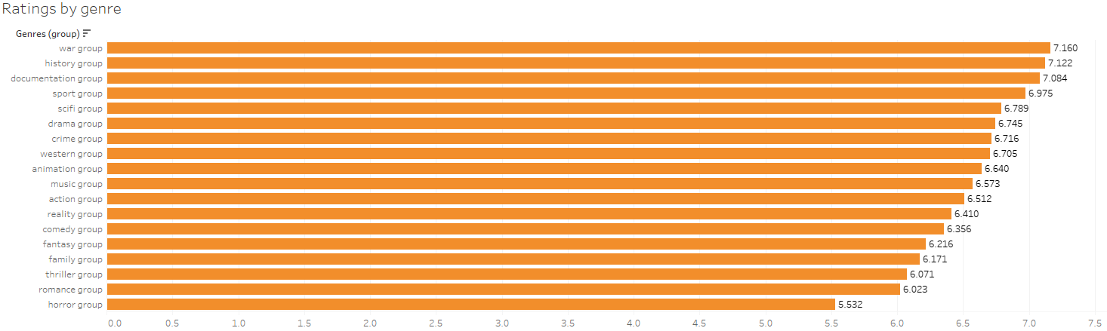
IMDB Rating by Genre
Top genres:
War films - avg rating of 7.160
History films - avg rating of 7.122
Documentaries - avg rating of 7.084

Slide 11


Enrich Less Popular Genres
There are 5738 titles but the top rated genres only account for
War films ~.75% of all titles
History ~.16% of all titles
Documentaries ~10.3% of all titles

Slide 12

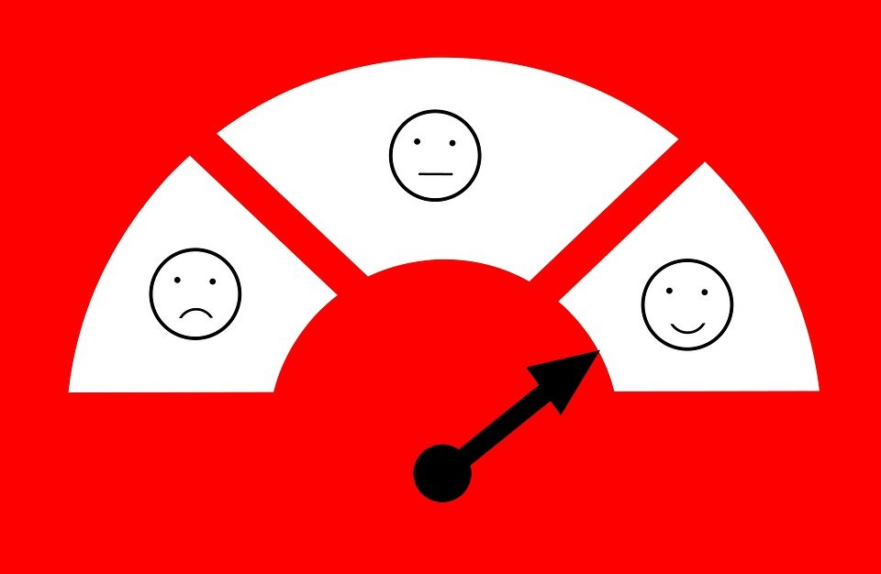
The Takeaway
Since some genres are very highly rated but have very few titles to explore, adding more titles will allow people to:
Explore more related options
Have more related films to list in home page
Spend more time watching instead of searching (increasing satisfaction)

Slide 13
The Takeaway
The main thing to remember is that more options leads to happier customers.
Happier customers means less churn!
Less churn leads to more money!

Slide 14


Next Steps!!
We know:
Some popular genres are being overlooked for new content
We predict:
Adding new content to these categories will encourage viewing related movies

Slide 15
Next Steps!!
Let’s use data science to learn the best films to add!
What we need
Netflix Budget Data (how much to acquire new title rights)
IMDB Web Scraping (new film ratings, budget prices, etc)
Build a model to try and predict how these changes will affect viewer hours (and indirectly their satisfaction)

Slide 16

Future work
A potential model could be a regression model trying to predict a continuous variable (viewership hours) by using existing variables and gathering some new ones!

Slide 17
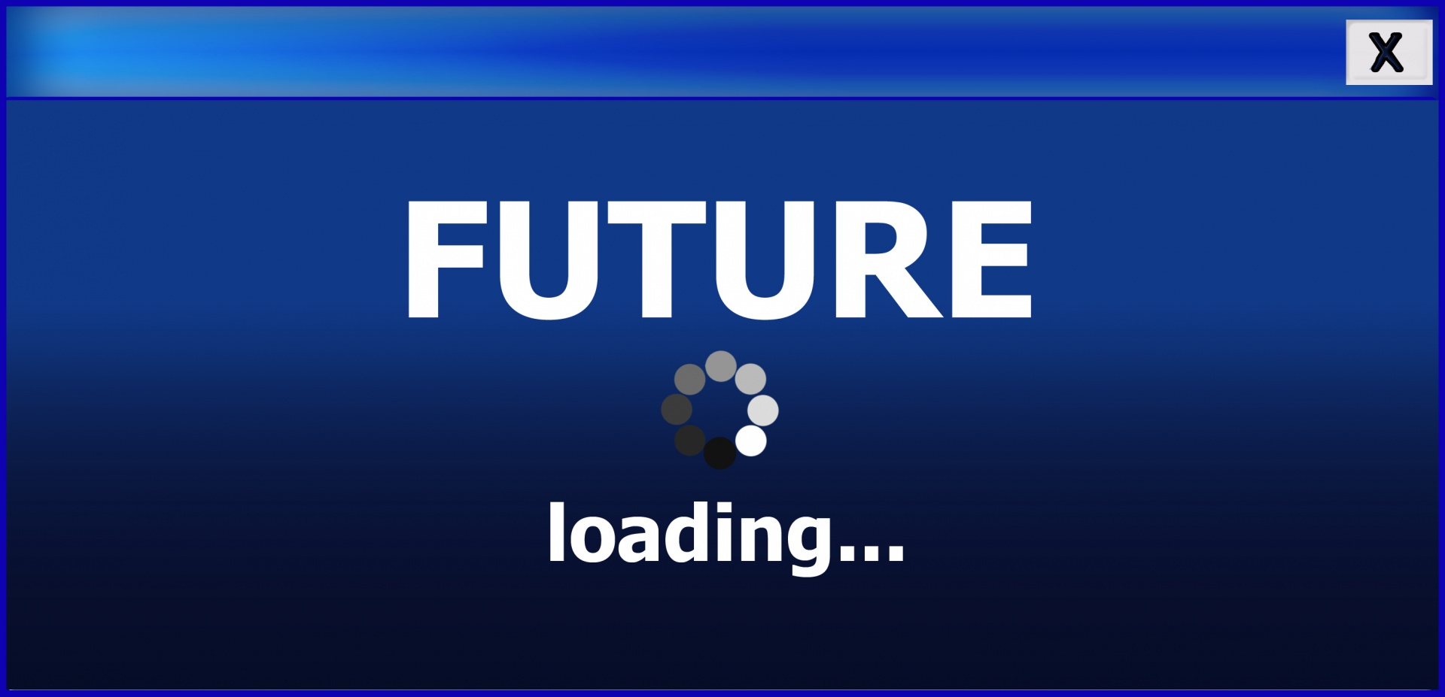
Future work
The model could predict
viewership hours
Using variables like
Imdb rating (already known)
Has the user watched a related film recently? (need to gather)

Slide 18


Future work
The purpose of this model will lead to improvements like:
More diverse selection within a specific genre
Happier members, leading to less churn and more retention
Higher understanding of member preferences for future title selection

Slide 19
END

